Slide 1

Hand Gesture Recognition for Indian Sign Language using
Deep Learning

Slide 2
Our Team
Group ID: PCSE25-05
Abhinav Singh
[5 sem
CSE ]
Disha Goel
[5 sem
CSE ]
Akshat Verma
[5 sem
CSE ]
Aayush Kumar
[5 sem
CSE ]
Guide: Mr. Umang Rastogi Sir

Slide 3

Objectives
Hand Gesture Recognition for Indian Sign Language using Deep Learning" is to create a system that can recognize and interpret hand movements used in Indian Sign Language (ISL).
The goal is to compile a comprehensive dataset specifically for Indian Sign Language, which will be used to train the hand gesture recognition model.
Utilizing natural language processing techniques, the aim is to convert individual words into coherent sentences while considering the grammatical structure and rules of the language.
The objective is to apply sentiment analysis to the generated sentences in order to understand the overall context and sentiment expressed within the text.

Slide 4
Continuous Sign Language Recognition and Its Translation into Intonation-Colored Speech
JOURNAL-
Literature review
YEAR -
2023
TECHNIQUES
FINDINGS
SHORTCOMINGS
sign language recognition
natural language processing
intonational speech synthesis
long short-term memory
spatiotemporal features
Integrated Approach for Sign Language Recognition:
Scientific Novelty in Sign Language Recognition
Integration with NLP Processor
Intonation Study:
Quality of Gesture Recording
Minimum Frame RequirementEthical Considerations
Specificity to Kazakh Language
Commercialization Potential

Slide 5
Vision-based Hand Gesture Recognition for Indian Sign Language Using Convolution Neural Network
JOURNAL-
Literature review
YEAR -
2023
TECHNIQUES
FINDINGS
SHORTCOMINGS
Indian sign language Recognition
Convolution Neural Network
Image Processing
Edge Detection
Hand Gesture Recognition
Effectiveness of CNNs for Hand Gesture Recognition
Method Choice Depends on Requirements
Importance of Large and Diverse Datasets
Recognition Accuracy Improvement
Real-time Implementation Challenge
Specific to Indian Sign Language

Slide 6
ISL Dataset
Indian Sign Language (ISL) serves as the basis for the dataset used in this study. We have personally built a dataset for all 26 English alphabets in ISL, as there was not a complete and legitimate dataset accessible. They employed a variety of data augmentation techniques and took many photos of each alphabet being finger-spelled. Approximately 150,000 photos total, or 5,500 images per letter, made up the final dataset. The majority of the photos used the same background to keep things consistent, and several lighting settings were employed to guarantee the robustness of the model.

Slide 7
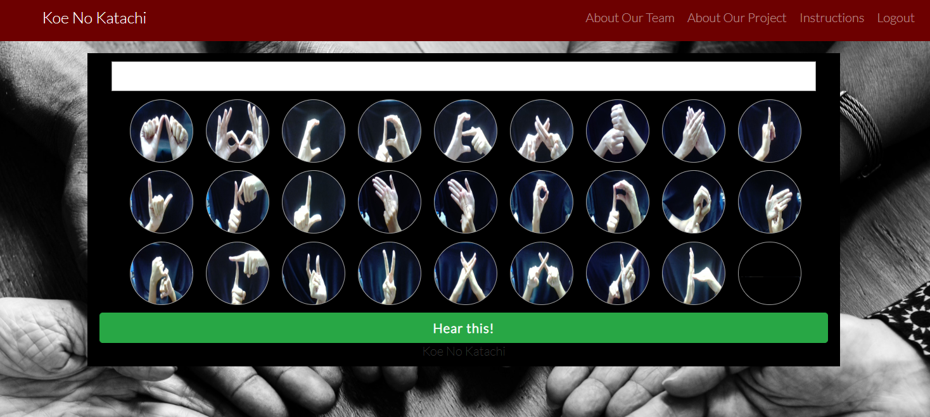

Slide 8
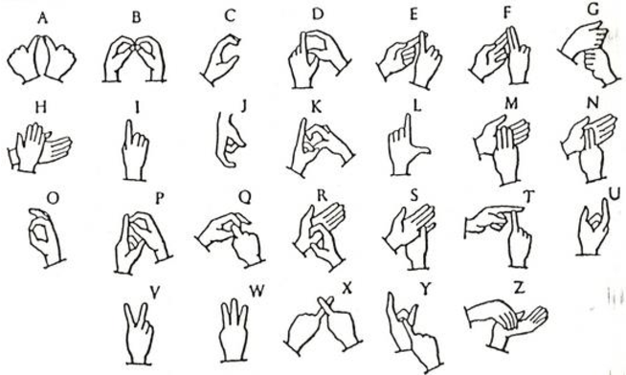


Slide 9
Deep Learning Model
Deep learning models, such as Convolutional Neural Networks (CNNs) and Recurrent Neural Networks (RNNs), will be developed and put into use throughout the model development phase in order to detect and comprehend ISL hand movements. To understand the complex patterns and subtleties of sign language, these models will go through a rigorous training process using a wide range of datasets. In order to ensure that the models can accurately translate ISL gestures into text or speech in real-time, hyperparameters will be adjusted to maximize performance. With room for future development and improvement, the resulting models will open doors for hearing-impaired people to communicate in a more inclusive and accessible manner.

Slide 10
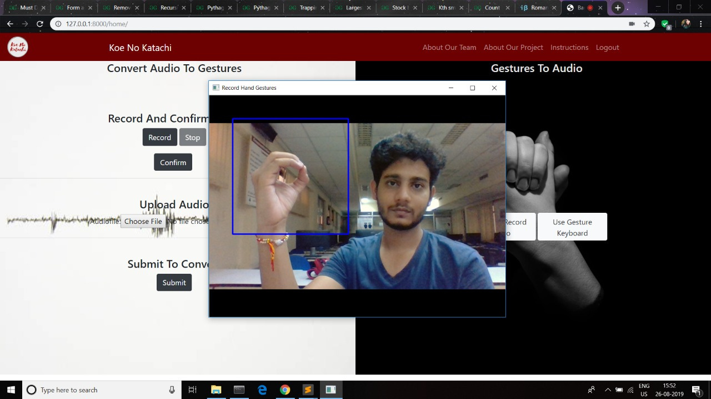

Slide 11
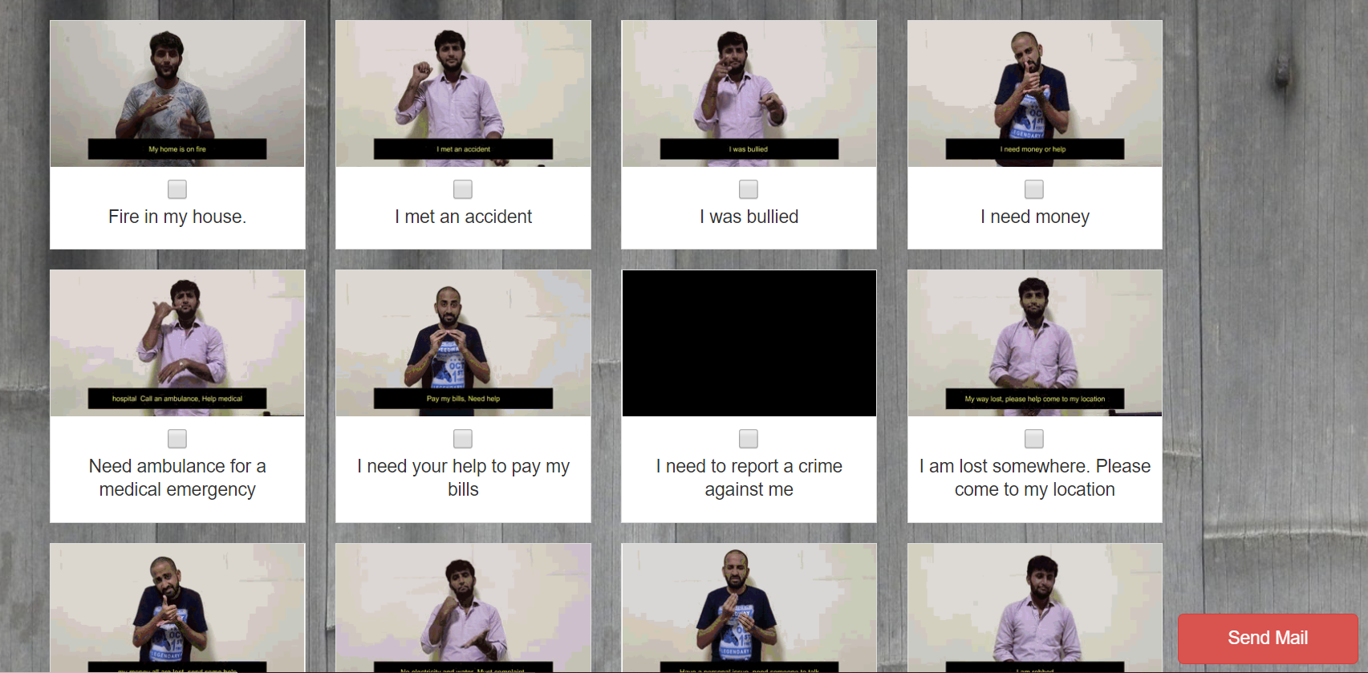

Slide 12
Thank You

